Slide 1
DB1 – Project 2
CAR RENTALS
BY
Karthikeyan Rajamani
&
Vineel Krishna Vellanki

Slide 2
Project features
Initial data from files are loaded using load infile
A trigger on the Table to update car availability
Records can be saved & edited
All transactions using Stored Procedures(Insert,update,delete)
Reports for All available cars & All returned rentals added.
Project hosted in AWS cloud
Uses RDS DB as a service in AWS

Slide 3
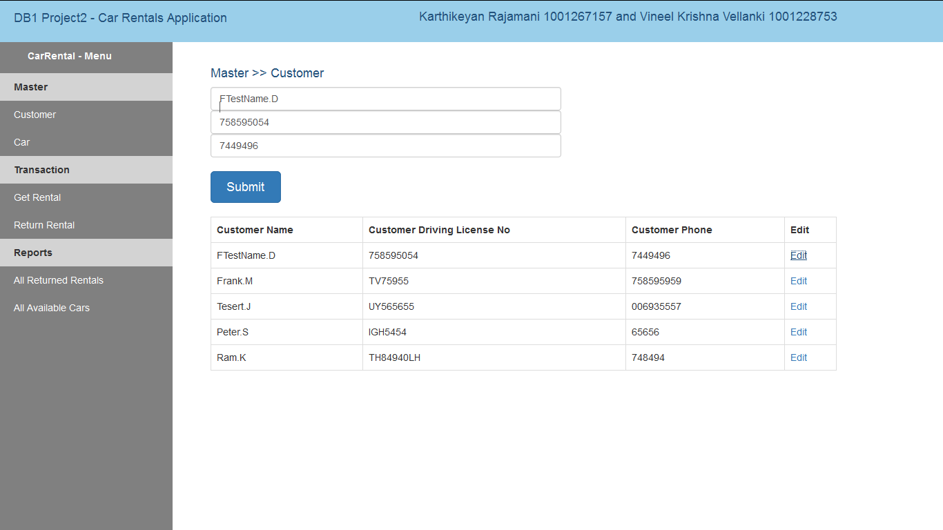
1.Customer – To add new customer details

Slide 4
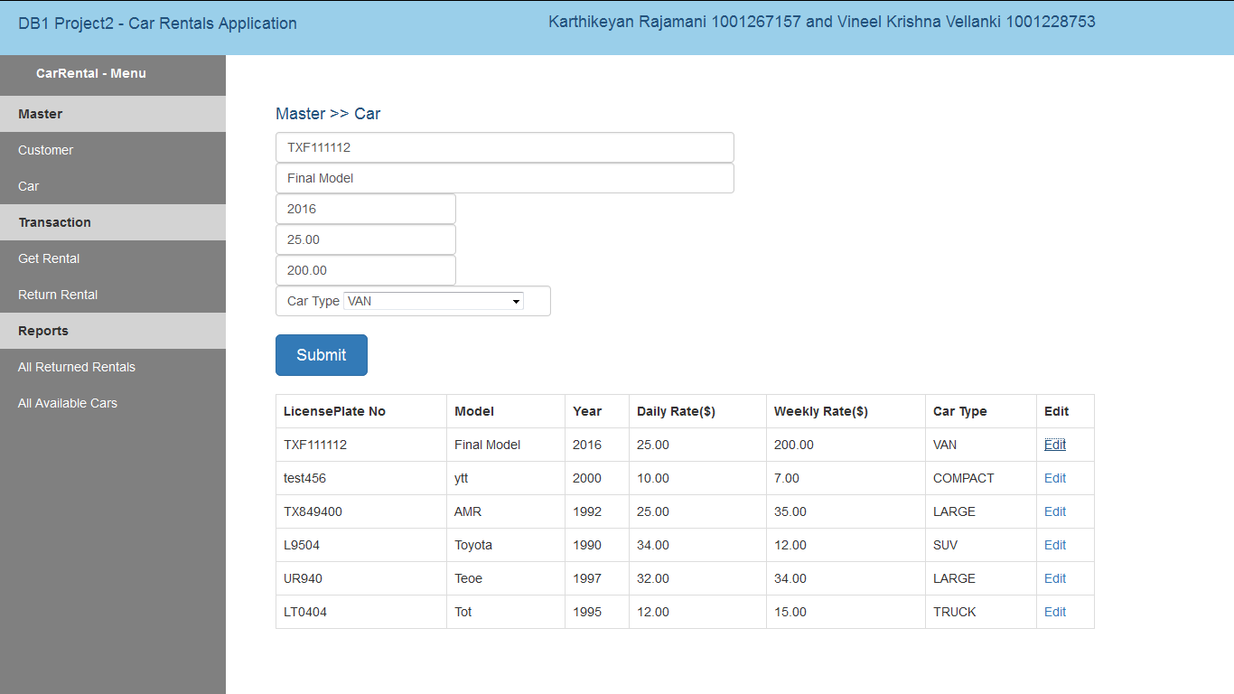
2.Car- To add new Car details with weekly and daily rates

Slide 5
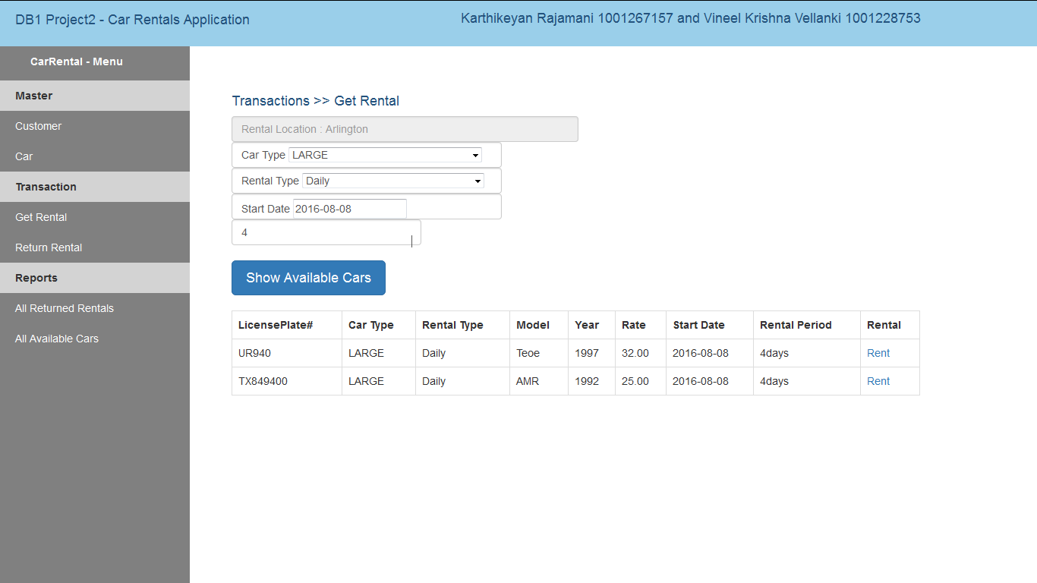
3a. To rent a car-Shows the available cars for the specified type and date

Slide 6
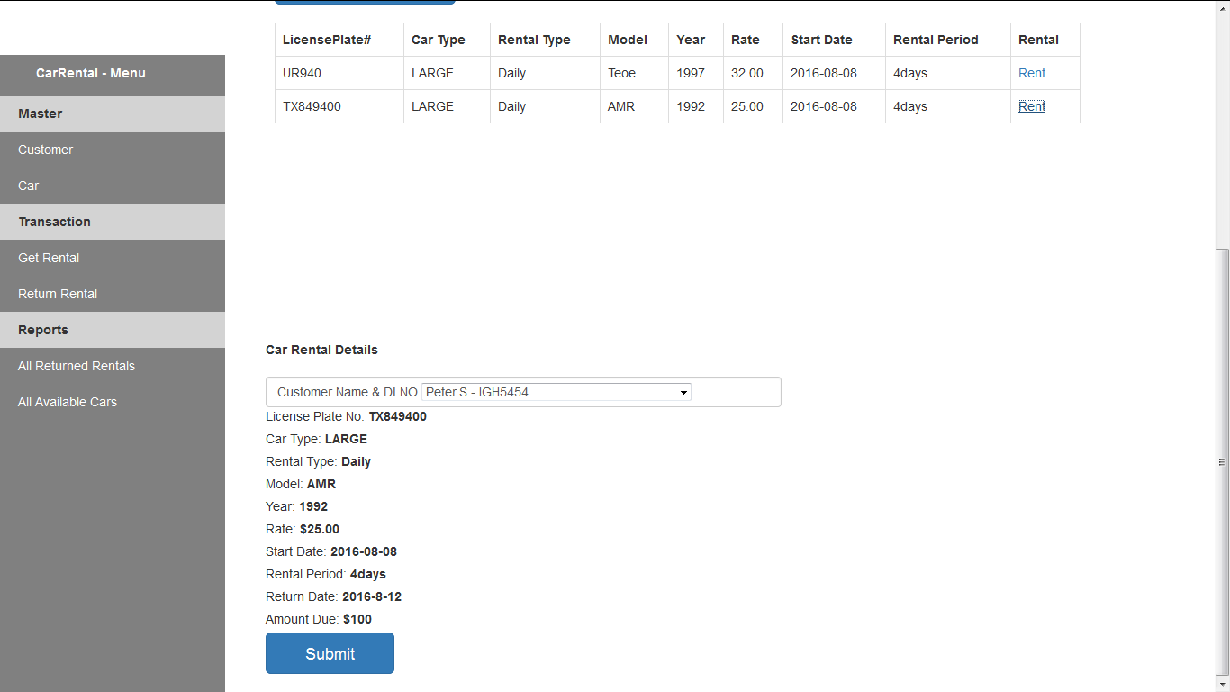
3b.To rent a car- Displays the details of the rented car and the customer

Slide 7
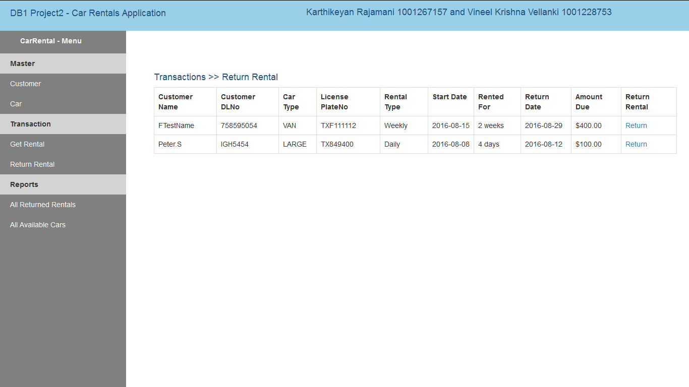
4. To return the rented car- Shows the details of all rented out cars

Slide 8
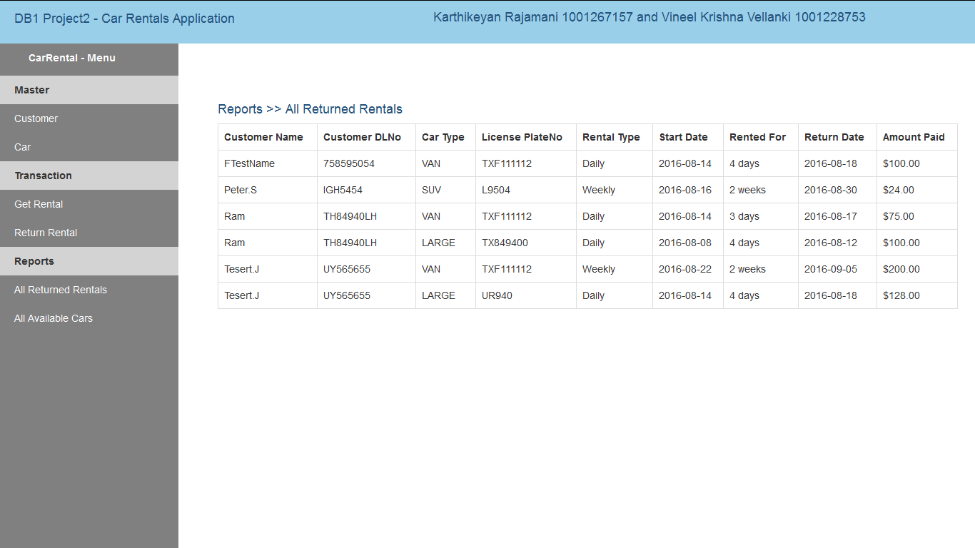
5. The report of all returned rental cars

Slide 9
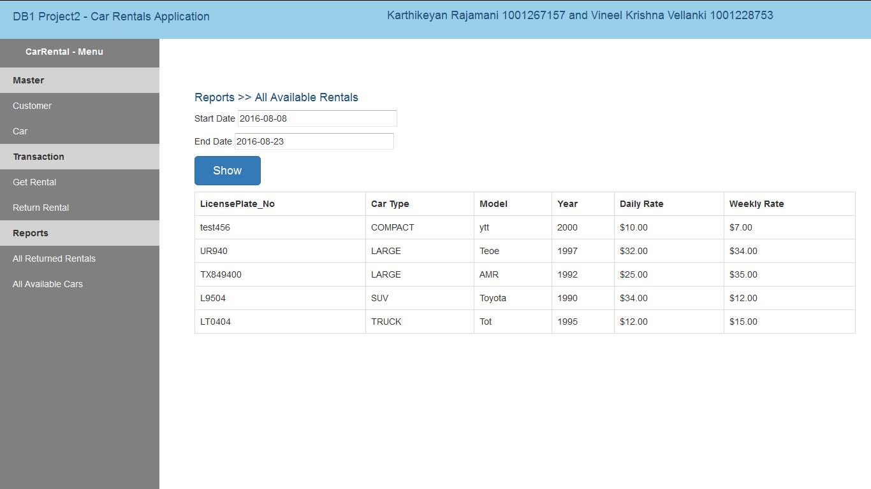
6. The report to show the available cars within specified dates

Slide 10
Thank you!

